Slide 1
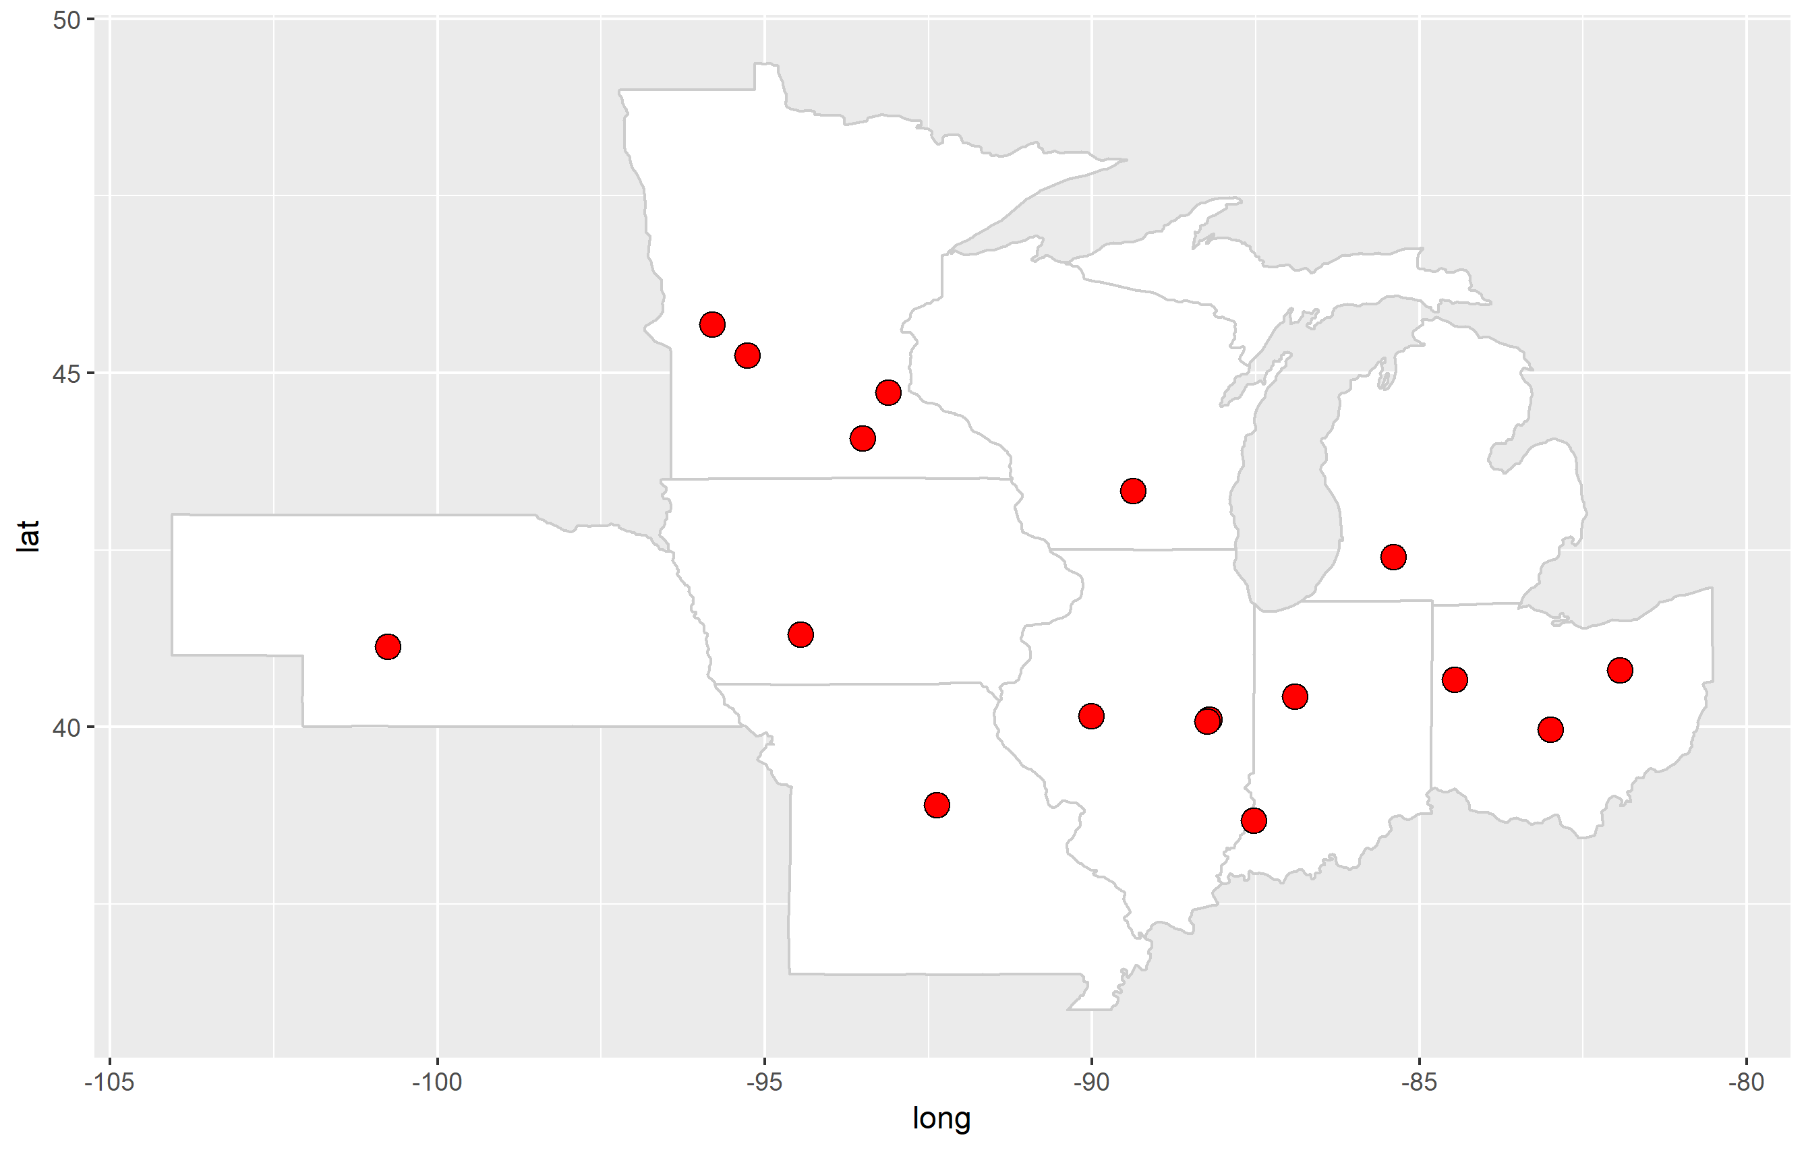
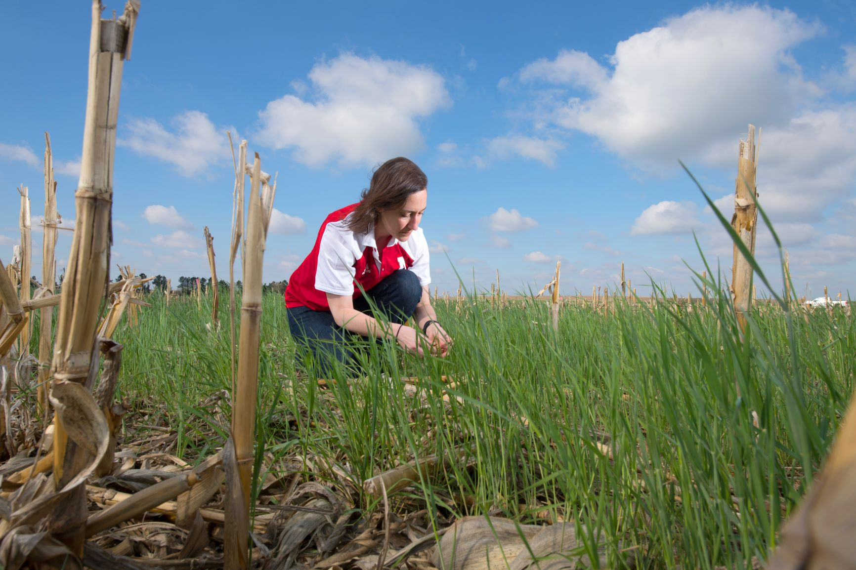
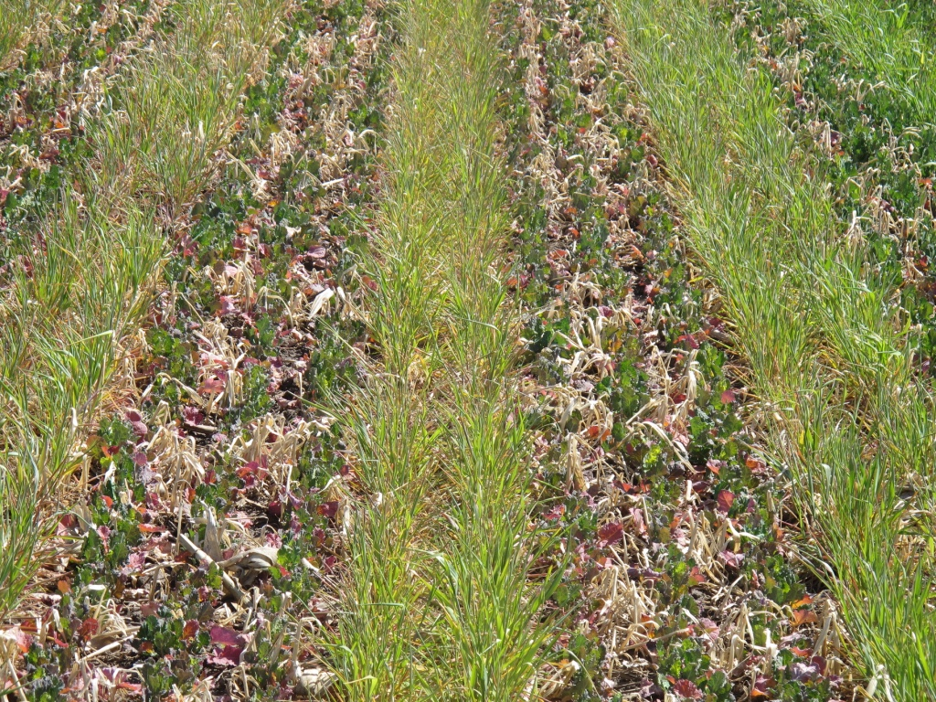
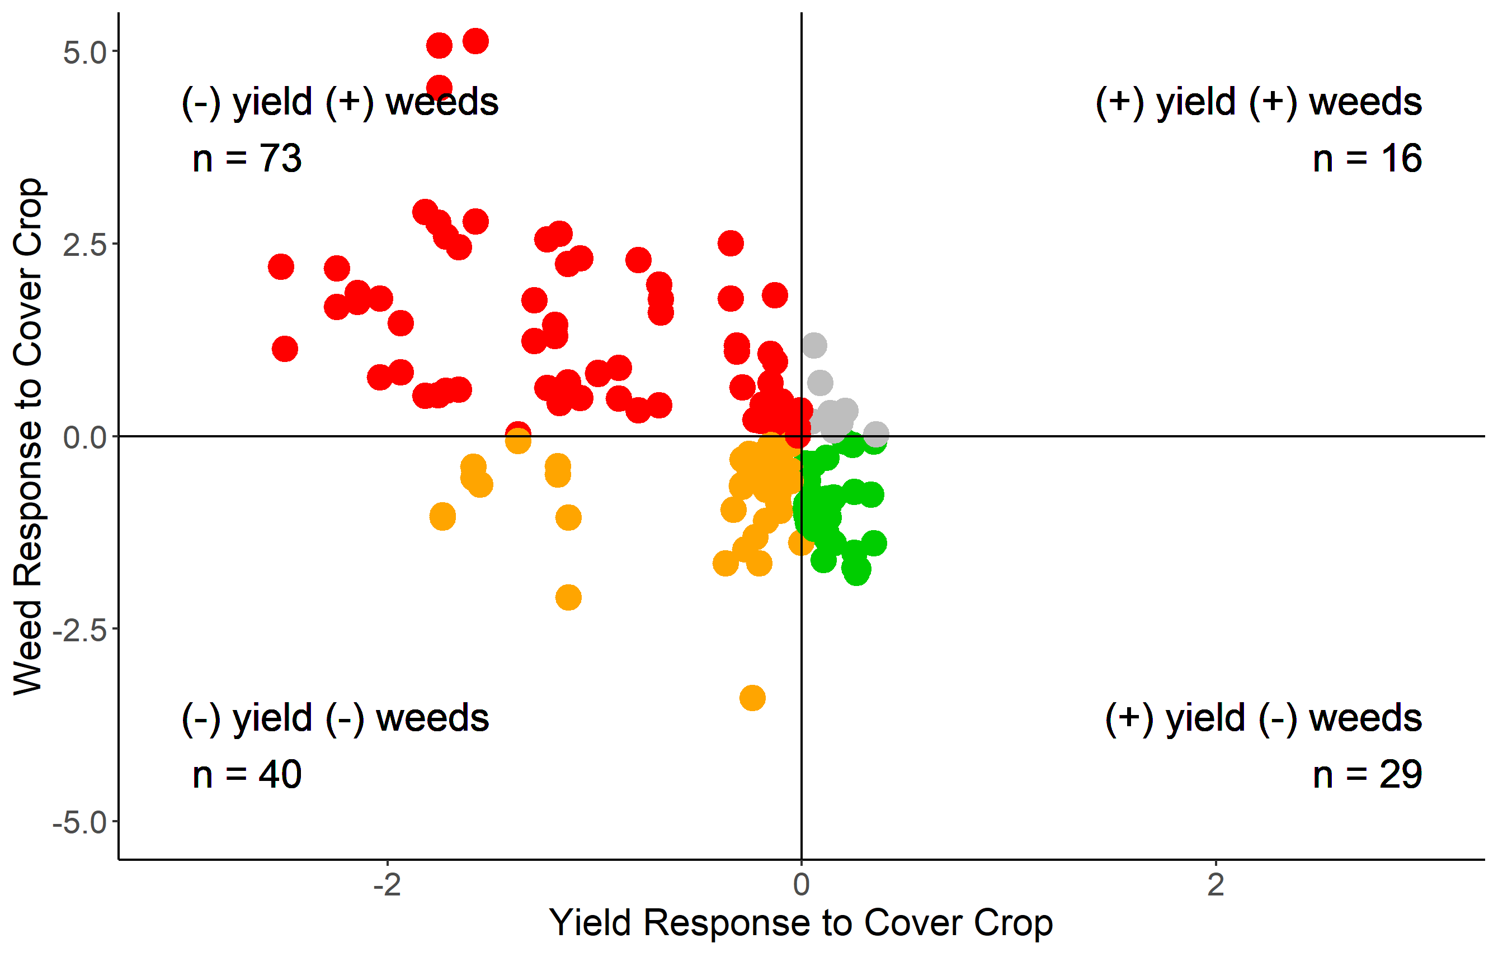
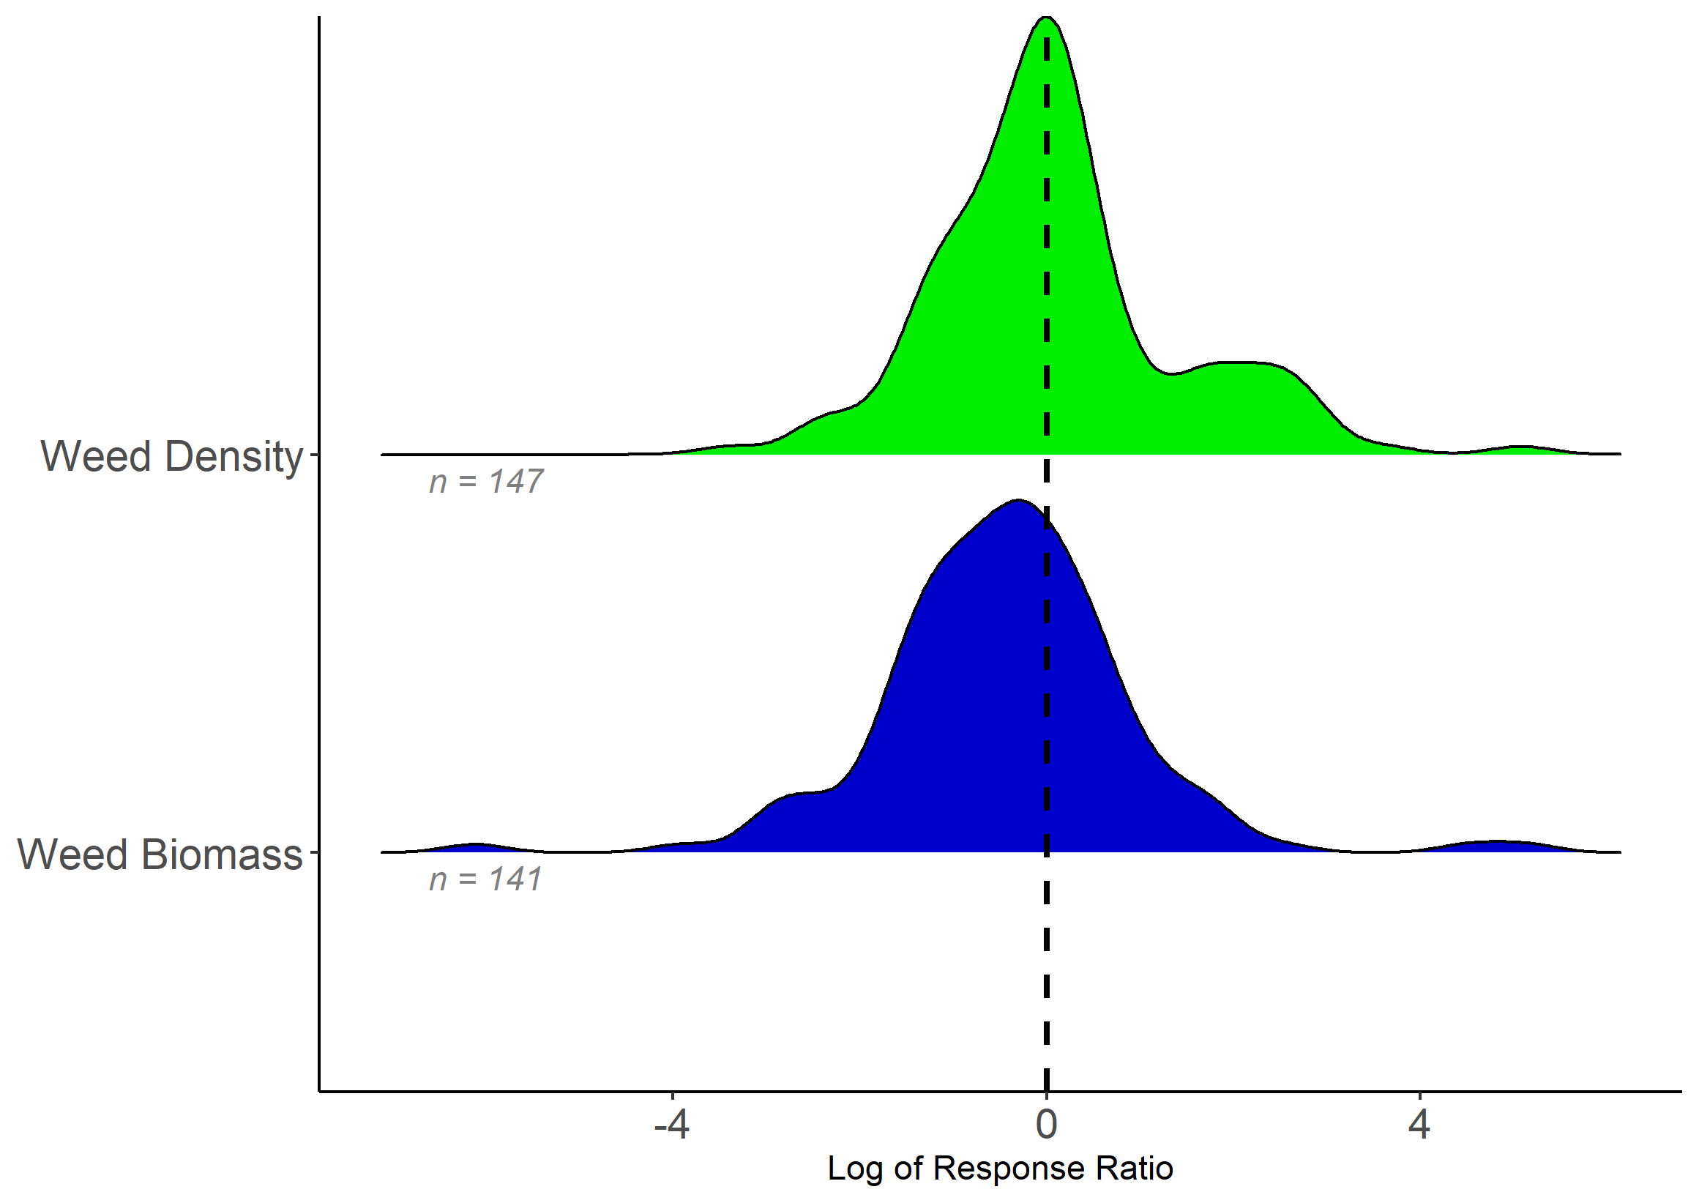
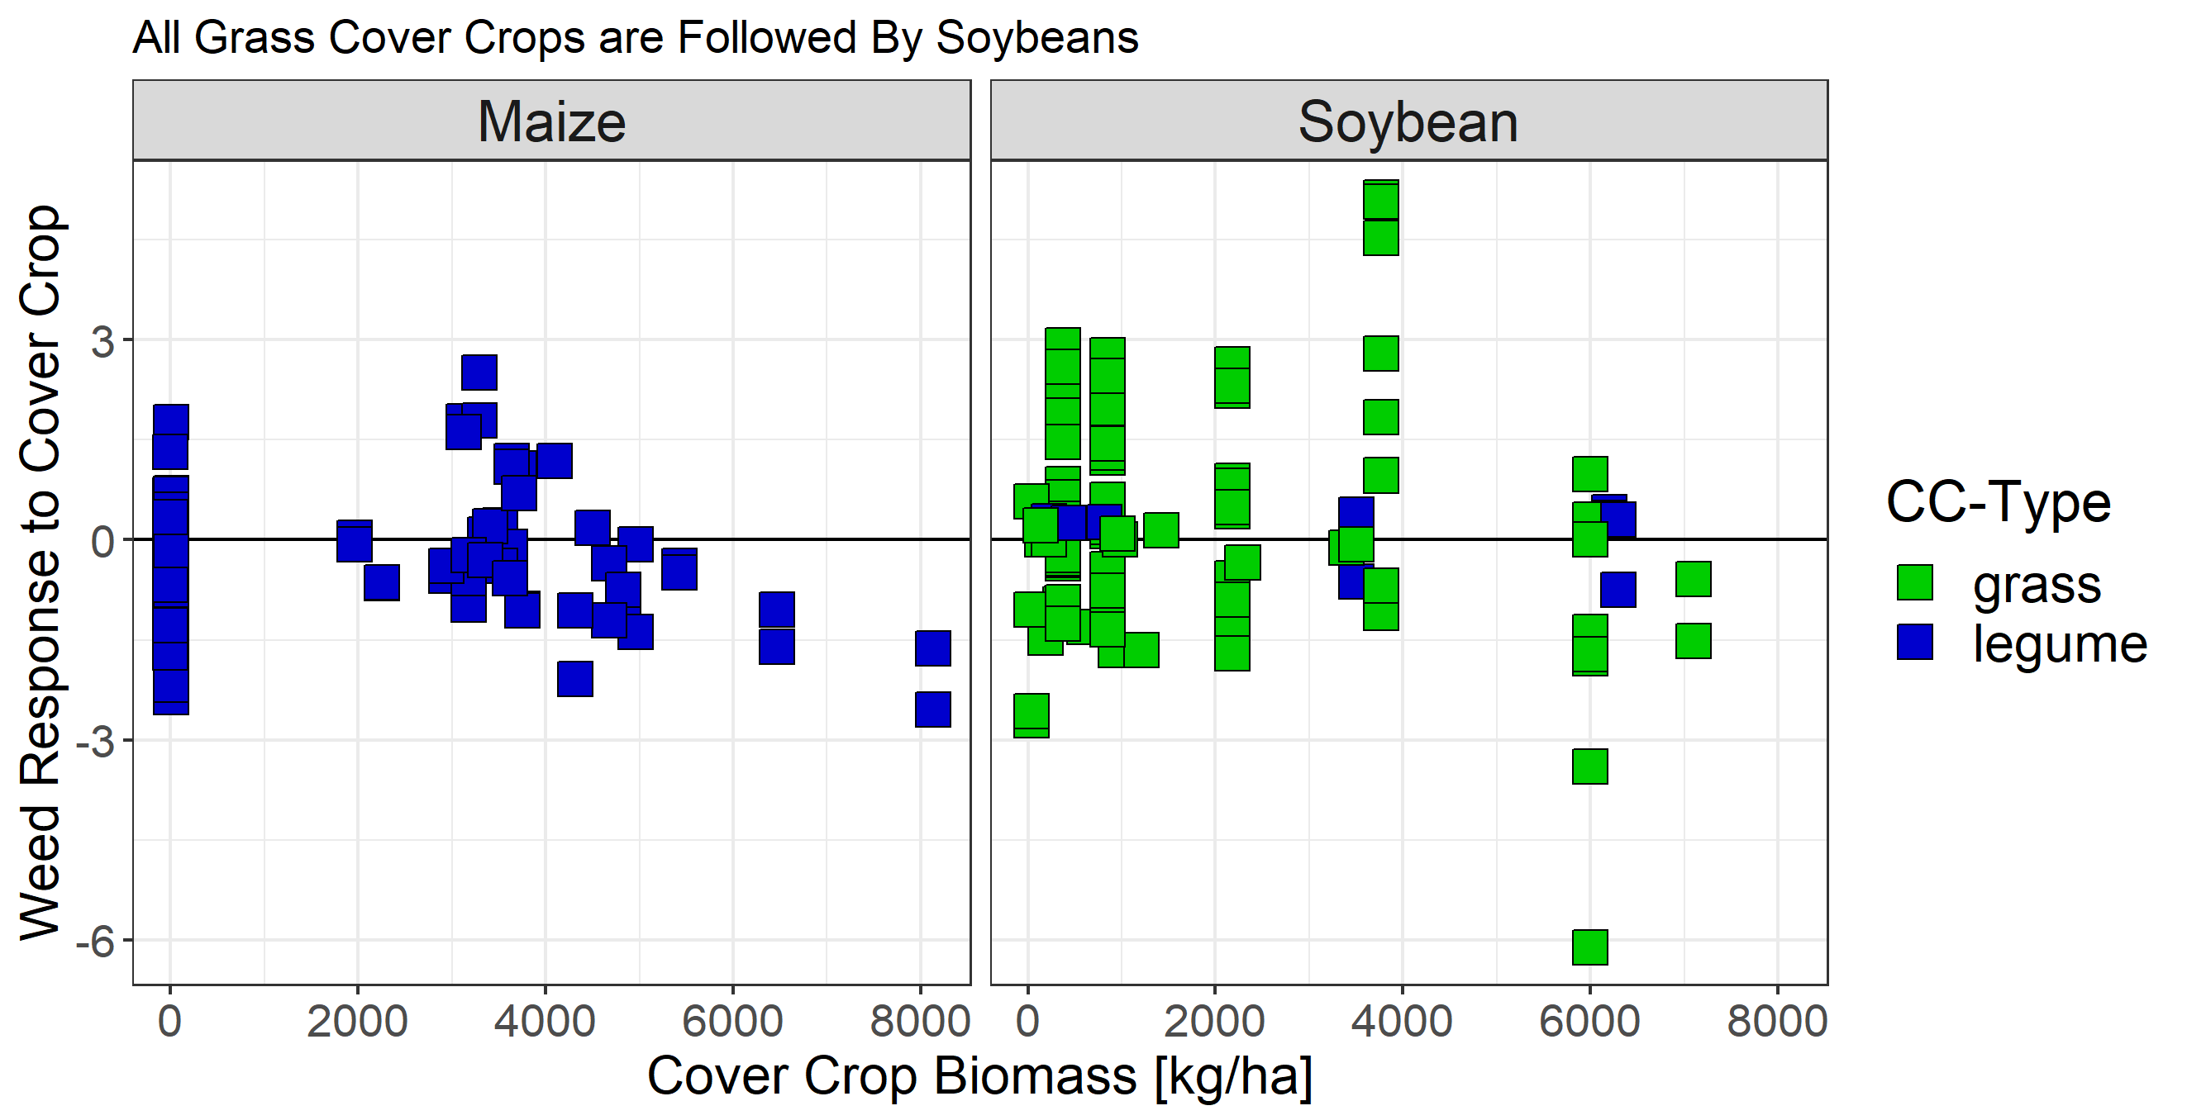
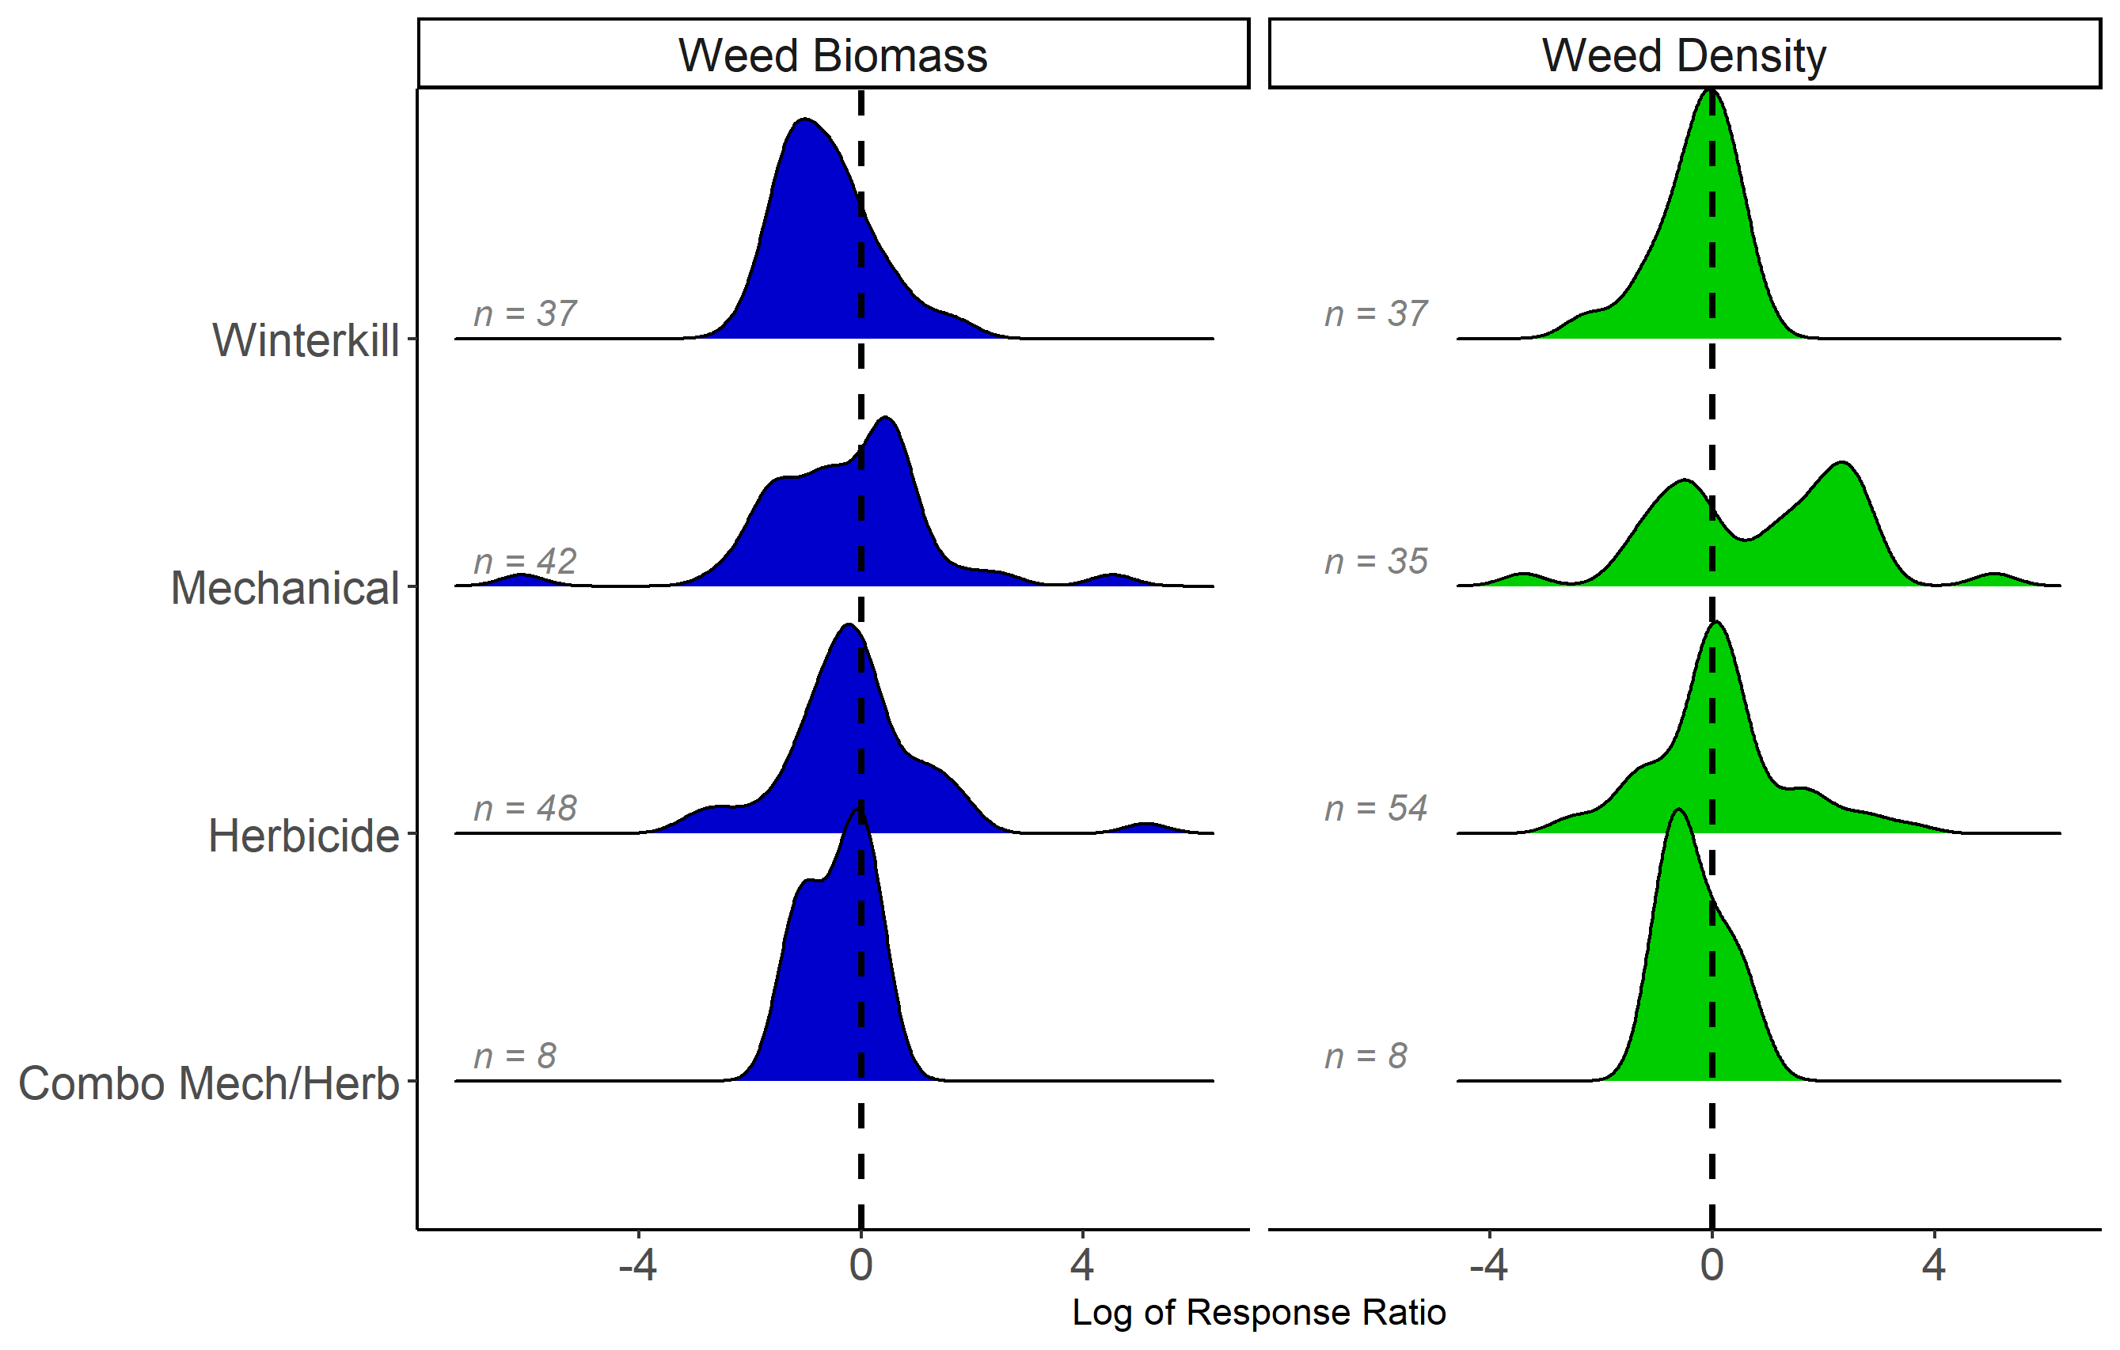



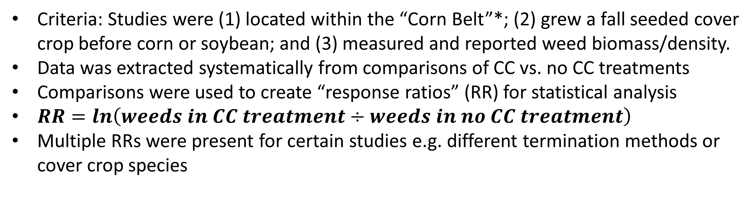
Do winter cover crops suppress weeds in Midwestern corn- and soybean-based systems?
A meta-analysis
Andrea Basche¹, David Weisberger², Virginia Nichols², Alisha Bower³, Chris Wilbeck³, Sarah Carlson³
1. University of Nebraska-Lincoln, Department of Agronomy and Horticulture, Lincoln, NE
2. Iowa State University, Department of Agronomy, Ames, IA
3. Practical Farmers of Iowa, Ames, IA
Rationale
Database Overview
Cover crop use may aid in reducing herbicide costs and in providing an alternative strategy for managing herbicide resistant weeds, both important cost savings that improve short-term economics for producers.
The climate and cropping systems of the Midwestern Corn Belt constrain cover crop growth and adoption.
The degree to which cover crop type, fall planting date and spring termination method affect weed management is not well understood.
The quantity of cover crop biomass needed for a significant reduction in weeds is also uncertain.
We conducted a meta-analysis to help answer these questions and to quantify the effects of winter cover crops, and their management, on weeds.
State | Year | Cover crop species | Corn or soybean following cover crop | Authors
OH | 1993 | vetch | corn | Hoffman et al.
MI | 2001 | clover, medic | corn | Fisk et al.
IL | 2002 | vetch | corn | Czapar et al.
OH | 2003 | wheat, vetch | corn, soybean | Gallagher et al.
MN | 2005 | rye | soybean | DeBruin et al.
IL | 2010 | rye, vetch | soybean | Davis et al.
WI | 2011 | rye | soybean | Bernstein et al.
IA | 2012 | mixes | corn, soybean | Delate et al.
MI | 2012 | rye/vetch, vetch, rye | - | Hayden et al.
IN | 2012 | wheat, ryegrass | corn, soybean | Mock et al.
MN | 2013 | rye | soybean | Forcella et al.
MN | 2016 | radish | corn | Gieske et al.
MO | 2017 | pea, vetch, clover, radish, oat, ryegrass, rye, wheat | soybean | Cornelius and Bradley
IL | 2017 | radish, canola, rye | soybean | Crawford et al.
NE | 2018 | rye | corn | Werle et al.
Locations of experiments (above) and meta-data (left). *Only Illinois, Indiana, Iowa, Kansas, Michigan, Minnesota, Missouri, Nebraska, North Dakota, Ohio, South Dakota, and Wisconsin were potentially included because we were concerned with the continuous Corn Belt states in the Midwest with the greatest number of corn and soybean acres.
Objectives: 1) Quantify weed control from experiments in corn-soybean cropping systems in the Corn Belt using fall planted cover crops; 2) Identify cover crop management practices required to achieve optimal weed control
Results
(Right): Yield and weed responses. When experiments included yields we found that cover crops represented “win-win” scenarios 18% of the time, where weeds were reduced and yields were increased. These data are represented by the green points in the figure to the right. “Lose-lose” situations (weeds increased and yield decreased) are in red.
Literature search and database development
Weeds decreased in cc treatment
Records identified through Web of Science keyword search = 676
Keyword search string: (weed* AND ("cover crop*" OR "green manure" OR "catch crop*") AND ("corn" OR "maize" OR "soybean*"))
Weeds increased in cc treatment
Records excluded = 456
Most common reason was that studies were clearly not relevant based on abstract/title
(Left, top): Overall results. Response ratios represent the natural log of weeds (biomass or density), where a negative value represents experiments where cover crops reduced weeds. Cover crops decreased weed density in 48% of response ratios, and cover crops decreased weed biomass in 64% of response ratios.
(Right) Cover crop biomass and crop following the cover crop. Greater levels of cover crop biomass tended to have a greater impact on weed control, particularly before corn.
Full text articles screened for eligibility = 220
Full text articles excluded = 169
Most common reasons: weeds were not measured; studies were not located in Corn Belt States*; did not include cropping systems or experimental design that would allow for a true control to experimental comparison; grew a spring vs. fall seeded cover crop
Below: Termination methods. Winterkill, herbicide and dual methods of cover crop termination were more effective at suppressing weeds with cover crops, and our preliminary statistical analysis suggests that there are significant differences between these groups for both weed biomass and weed density. There was one notable study (DeBruin et al. 2005) where weed density was continually increased in the cover crop treatment when rye before soybean was mowed.
Articles included in qualitative synthesis ~16 review articles
Articles included in quantitative synthesis = 15 to date, ~20 left for full screening
Additional Questions Generated
Are there interactions with cover crops and herbicides that make herbicides more or less effective?
How much biomass is needed to consistently reduce weeds?
How might a cover crop be creating a more favorable environment for weeds?
What is the difference in weed control in overwintering or winter killed cover crops?
How does a cover crop impact weed germination and emergence?
Criteria: Studies were (1) located within the “Corn Belt”*; (2) grew a fall seeded cover crop before corn or soybean; and (3) measured and reported weed biomass/density.
Data was extracted systematically from comparisons of CC vs. no CC treatments
Comparisons were used to create “response ratios” (RR) for statistical analysis
$RR=ln\left(weeds in CC treatment÷weeds in no CC treatment\right)$
Multiple RRs were present for certain studies e.g. different termination methods or cover crop species

